Slide 1
1st NHS Meeting
October 23, 2017

Slide 2
Officers
President: Yailin Penaranda
01
Vice President: Claudia Ricardo
02
Secretary: Maria Pedroza
03
Treasurer: Meagan Mederos
04
Historian: Natalie Lamas
05
Sponsor: Monica Gonzalez
06

Slide 3
Social Media/Contact
Instagram: @hghsnhs18
Twitter: @hghsnhs18
Remind: Text 81010 @hghsnhs18
Need Help? Contact Ms. Gonzalez in room 2206, any NHS officer, or don’t be shy and text us through Remind

Slide 4
Club Dues
Due Date: November 15th
Fee: $30 (pays for your stole at the end of Senior year)
It’s $10/year, so those of you who have been in the club just need to pay the remaining amount of the $30
If for any reason you are struggling financially please speak to Ms. Gonzalez before November 15th

Slide 5
Requirements
3.5 Unweighted GPA or higher
Good Grades (Nothing lower than a C or multiple C’s)
30 Hours (Attending events/projects)
10 Points (Attending meetings and fundraisers)
Must plan and do either 1 long community service project (Tutorings throughout the year) or 2 short ones (A walk or collection of goods) within the year in or out of school.
Can be planned in groups of 3 people max
An online portfolio by the beginning of April on Turnitin.com with all you have done through and for NHS. (Code for Turnitin.com will be sent later on )
Proof will come from your portfolio!

Slide 6
Portfolio Requirements
Cover Page (Name, Grade, ID #, Picture, E-mail, and Phone #)
Table of Contents
Screenshot of GPA and grades for the 1st through 3rd nine weeks.
30 Hours (Screenshot of Before & After Selfies of you at event/project + a 2 sentence reflection)
10 Points (Selfies of you at meeting or selfies with your receipt at a fundraiser you attend for NHS + copy of receipt with your name and ID # on it)
Community Service Project (Next Slide)

Slide 7
Portfolio Requirements
Community Service Project/s
Contact Information (In or Out)
^{What it is?}
^{When?}
^{Purpose of project}
^{What is needed?}
^{Time}
^{Pics}

Slide 8
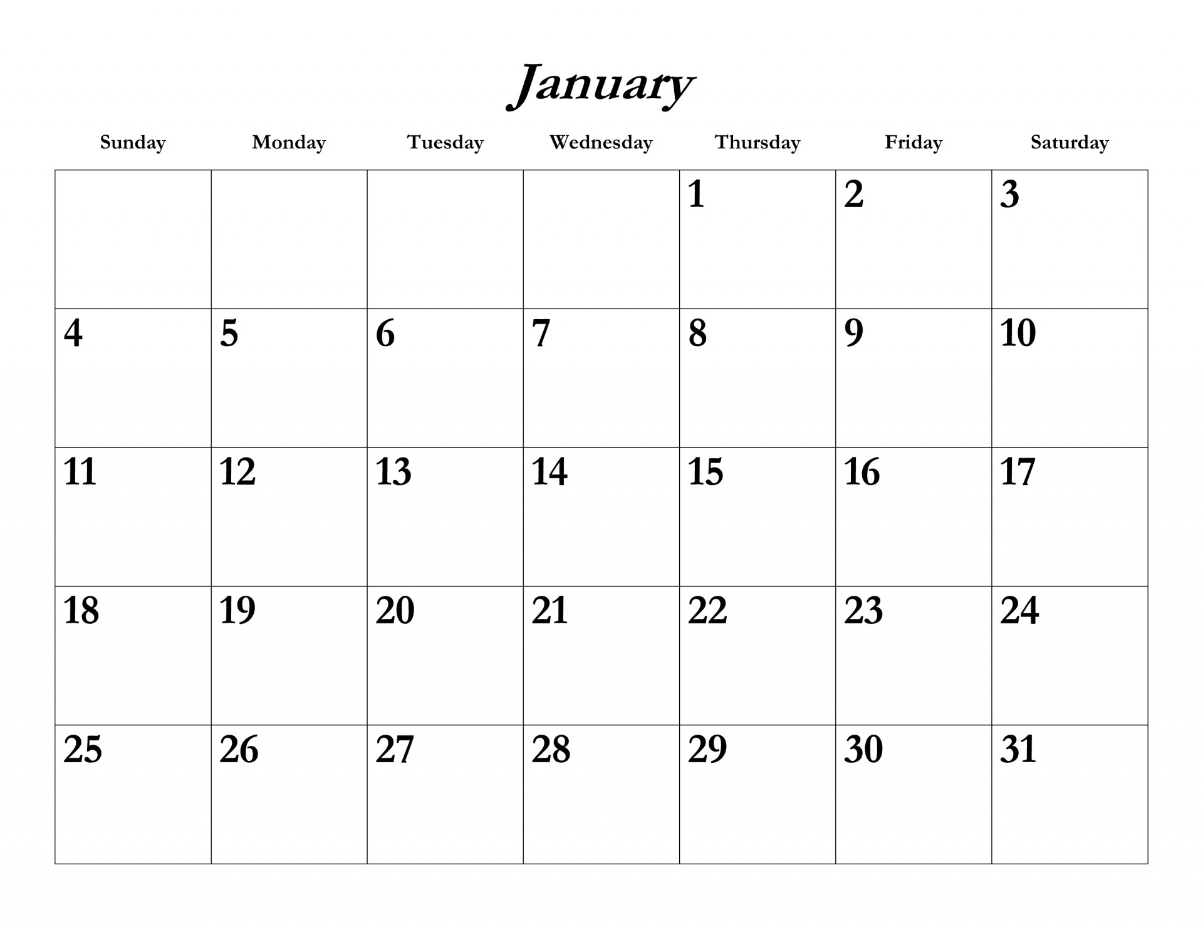
Meetings, Events, Fundraisers, & Points/Hours Opportunities
We are working on a blog in which you will be able to access a calendar with all available opportunities.
Sign up to the Remind by texting 81010 @hghsnhs18 – This is where you will be receiving all needed info for now, including upcoming meetings!

Slide 9
Thank you for coming!
From: Your NHS Officers

